Slide 1
LONG CASE PRESENTATION
DR. PRAVIN SURVASHE
ASSISTANT PROFESSOR (NEUROSURGERY)

Slide 2
My patient Mr.GAJANAN KUSANDE a 38 year old right handed gentleman
residing at Mandwa,farmer by occupation and educated till 8 th standard came with

Slide 3
CHIEF COMPLAINTS -
Headache with blurring of vision – 1 yr
Tinnitus in Lt ear – 6 month
Decreased hearing on Lt side – 4 month
Abnormal deviation of angle of mouth to Rt side -1 month
Imbalance while walking – 1 month

Slide 4
Patient was apparently all right 1year back ,when he started getting mild headache. It was insidious in onset and intermittent initially however over next 3-4 months frequency and intensity increased and he started getting it daily. Headache is holocranial, dull aching more in morning hours and subsides by afternoon.
It is associated with bilateral visual blurring since last 3-4 months and blurring is maximum at the height of headache.
since last one month symptoms are aggravated and are associated with multiple episodes of nonbilious, projectile vomiting. Headache subsides after vomiting.
Not associated with transient blackouts
No excessive lacrimation, redness of eyes, photophobia
For this he had shown to doctors multiple times and used to take over the counter analgesics on and off. He also had received refractory correction and changed his glasses 2-3 times.

Slide 5
6 months back while falling asleep in night he started getting ringing sound in Lt ear though It was not audible to any other family members
Next morning he cleared some wax from the ear but the ringing sensation persisted. It was intermittent initially but over next 1 week it became continuous, increased in intensity and started interfering with his routine activities like talking on phone, watching TV or regular conversation and sleeping also.
He could not observe any pulsatile variation of sound correlating with heartbeats
Change in intensity of sound with changing head position.

Slide 6
Gradually he noticed his hearing is also decreased on Lt. side as, while talking to people he had to turn his Rt. ear to them and had to use Rt. ear while talking on mobile phone.
Hearing decreased over the period so that at present he cant hear normal conversation from Lt side.
Relatives also noticed that he is talking in loud voice since last 4 months.
NO H/O
Earache , ear discharge
Prolong exposure to loud noise
Exposure to ototoxic drugs.
Trauma with bloody discharge
Fluctuating changes in hearing loss.
Hearing better in noisy surrounding.

Slide 7
1 month back as he was going to farm he started experiencing imbalance while walking and drifting towards left side. Gradually he also noticed that he has to stand with a broad based stance else he used to sway /fall to Lt side.
Imbalance worsened rapidly and within one week he became homebound and started taking support while standing and walking.He also started getting giddiness immediately after getting up from bed which used to settle within few seconds.
He was troubled while doing any activity with left hand like holding news paper or cup of tea. His hand started swaying while reaching the objects and used to overshoot them.
No h/o abnormal movements of limbs at rest
No h/o weakness of limb
No h/o difficulty in feeling ground or slipping of foot wears
No h/o worsening the instability in dark or with closed eyes.
No h/o difficulty in negotiating through narrow passages and sudden turning backwards while walking.

Slide 8
1 months back while sleeping patient’s relatives noticed that his left eye is remaining open. Next morning while washing the face he noticed it and attempted to close Lt. eye but was not possible. He also noticed that his Lt. eyeball was moving upwards with every attempt of eye closure and even Lt half of forehead is devoid of wrinkles.
In next 4-5 days he noticed while talking and laughing his angle of mouth started deviating to Rt side also while eating food was getting accumulated in Lt. side of mouth. Some times he had to use fingers to clear food from Lt side. Gradually saliva started drooling from Lt angle of mouth at rest also.
He started experiencing difficulty in speaking and articulating words.
and noticed decreased taste sensation on left side.
No h/o Abnormal involuntary movements of face.

Slide 9
Negative history -
No h/o
Supratentorial -
Impaired memory, intellect and comprehension.
Convulsions.
Cranial nerves -
Decrease smell sensation
Abnormal deviation of eyeballs, drooping of eyelid.
Loss of sensation over face, difficulty in chewing, shock like sensation over face during chewing, brushing etc.
Nasal regurgitation of water,difficulty in swallowing food, hoarseness of voice.
Difficulty in raising arm above shoulder, turning neck sideways.
Difficulty in moving tongue, abnormal tongue movements at rest

Slide 10
Long tract signs -
Weakness of limbs
Sensory loss in any part of body
Bowel, bladder incontinence.
Features of Horner’s syndrome
General -
Fever, neck stiffness .
Waxing and waning course of symptoms
Weight loss

Slide 11
Provisional diagnosis.
38 year old man with gradually progressive symptoms -
morning headache with blurring of vision with tinnitus and decrease hearing in left ear with facial paresis on lt side with imbalance while walking and tendency to fall on left side even with eyes open
suggestive of Lt C.P angle cistern lesion most likely acoustic schwannoma.
Differential diagnosis –
C.P angle meningioma
C.P angle epidermoid.
Osteosarcoma.

Slide 12
Family history –
Not contributory
Past history –
No h/o Repeated respiratory tract infections, ear discharge, trauma, surgery, radiation exposure
Other major illness – like koch’s and other comorbid conditions.
Personal history –
Bowel, bladder habits are normal
appetite – reduced
sleep – inadequate.

Slide 13
General examinations -
Averagely built and moderately nourished
P – 74 bpm
BP – 130/80 mm Hg supine position
No P/O/L/I/C/E
No neurocutaneous markers like skin nodules, hypopigmented patches etc.
NF2 – status.- negative
Spinal examination – normal.
Fundus – bilateral blurring of disc margin – Frisen’s Gr 2

Slide 14
CNS -
CNS – Conscious,oriented to T/P/P
Following commands
GCS 15/15
HMF – Normal
MMSE score – 30/30
Memory – Recent/past – Intact
Language – Dysarthria - +
naming, writing, repetition, comprehension – Normal

Slide 15
Cranial nerves -
1 st –
Olfaction – b/l nostrils – normal
2 nd –
V/A – snellen’s chart without spectacles.
Rt – 6/18 Lt – 6/18
Color perception – normal bilaterally
Field defects – circumferential narrowing peripheral field noted bilaterally.
Fundoscopy – blurred disc margins on both sides.
Frisen’s gr – 2
Conjunctival congestion on Lt side +

Slide 16
3,4,6 –
EOM – Individual and conjugate – All direction and full range.
Nystagmus –
Horizontal
Fine and rapid on Rt side and coarse - Lt side
Fast component – Rt side
Fatiguable, gets suppressed on gaze fixation.
Pupil – 3mm RTL equally.
Light - direct/consensual light reflex – Normal
Accommodation reflex – N
No ptosis

Slide 17
5 th nerve
Inspection -
No deviation of mandible on opening the mouth.
No temporal hallowing or flattening of cheek.
Sensory –
Pain, touch, temperature over face – Normal bilaterally.
Motor –
Muscles of mastication(Temporalis/Masseter) –Tone – Normal
Mouth opening and jaw movements – normal.
Corneal, conjunctival reflex – N
Jaw jerk - N

Slide 18
7 th narve -
Inspection –
Lt. Eye closure – Partial
Bell’s phenomenon – Present
Nasolabial fold obliterated on Lt side.
Fore head wrinkling – Absent on lt side.
Angle of mouth deviated to Rt side while talking and smiling
Drooling of saliva from Lt side.
Puffing and pouting – air leaks from lt side of mouth.
No obvious facial muscle wasting, fasciculations.
Sensory – no e/o hypoesthesia at posterior wall of EAC.
Taste sensation – Absent on Lt side of anterior 2/3rd of tongue.
Schirmer’s test – 10mm – 5 min.

Slide 19
8 th nerve – COCHLEAR DIVISION
Test | Rt | Lt
Rinne’s | AC > BC | AC > BC both decreased
Weber | Lateralize to Rt side.
ABC | Same as myself. | AC/BC decreased compared to myself..

Slide 20
Vestibular division -
Nystagmus
Finger to nose test – Deviation of Lt hand to Lt side.
Rhomberg’s test – sway to Lt side even with open eyes.

Slide 21
9/10/11
Uvula – central
palatal folds –moving equally, no sagging
Gag reflex – N
12 –
Tongue movements normal
No atrophy, fibrillations ,deviation of tongue on protrusion etc.

Slide 22
Cerebellar signs –
FNF /F-F – Lt side
jerky, swaying and deviation to Lt side ,with intention tremors and pastpointing +
Rt side – Normal
Cerebellar drift – eyes closed – Lt arm drifts to Lt side +
Heel – knee test. – Movements are jerky ,non cordinated on Lt side
Dysdiadochokinesia – Impaired on Lt side.
Rhomberg– sways on Lt side with eye open
Tandem walk – not possible.
Broad based stance
Gait - Staggering,Lurching,swaying ,high stepping on Lt side - ataxic gait
Speech – dysarthria - slurred, jerky,explosive.

Slide 23
Motor examination – Power 5/5 in all four limbs
Sensory – Pain, touch,temperature,JPS and vibration sensations normal in all four limbs.
DTR - Rt Lt
Biceps ++ Pendulous
Triceps ++ Pendulous
Supinator ++ +
Knee ++ Pendulous
Ankle ++ Pendulous
Superficial reflexes –
Plantar reflex – B/l upgoing.

Slide 24
38 year old man with gradually progressive symptoms of tinnitus, decreased hearing ,facial paralysis,and imbalance while walking on Lt side with clinical examination suggestive of Lt side SNHL ,facial paralysis Gr 4,cerebellar ataxia and bilateral papiloedema Gr 2
s/o Lt. C.P angle lesion mostly acoustic schwannoma extending in to the cistern with hydrocephalus.

Slide 25
Investigations –
General – Routine anaesthetic fitness.
Audiometry –
Perimetry -
CT and MRI brain (P+C)

Slide 26
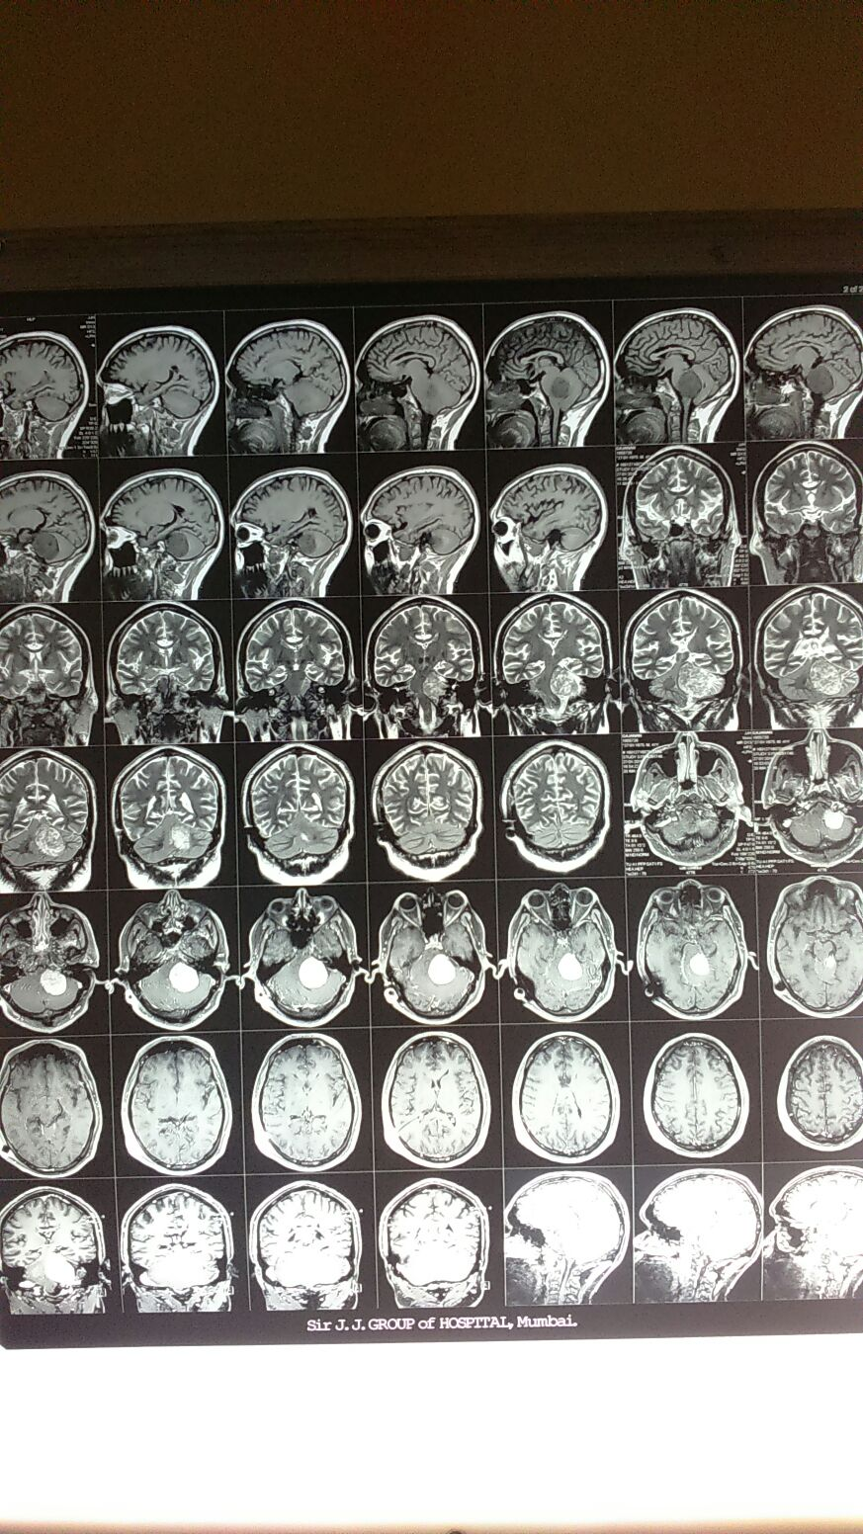

Slide 27
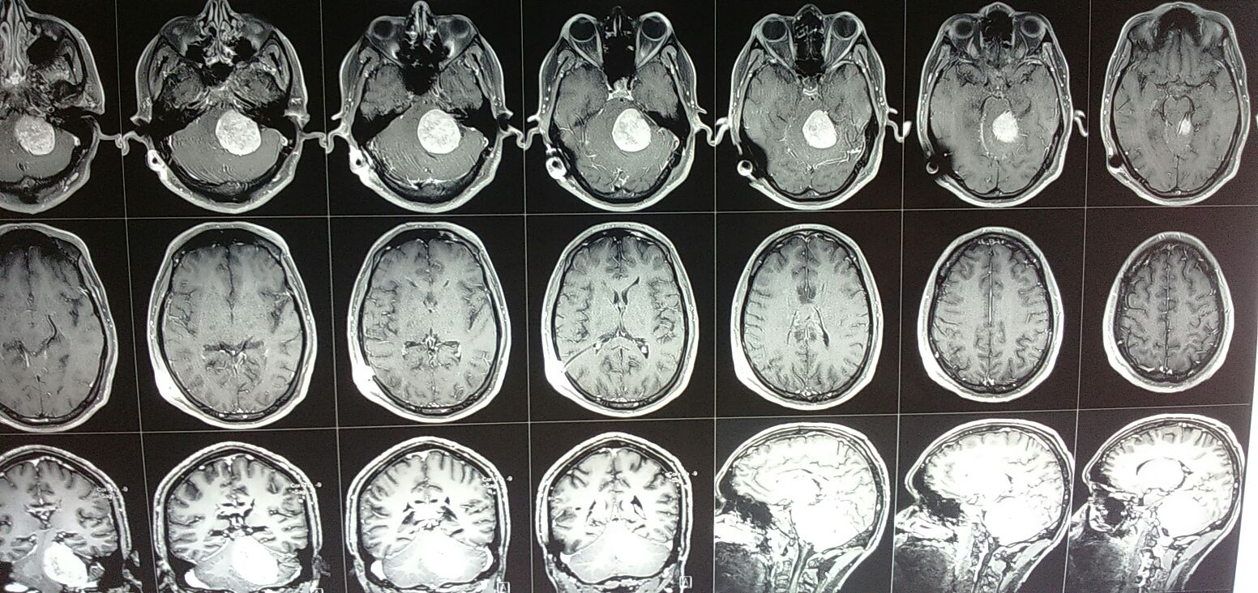

Slide 28
Treatment
Surgical excision with facial preservation. – Retrosigmoid approach.

Slide 29
Thank you - ---

